Slide 1
Animation Game Design using Multimedia Techniques
Zhenghao chen

Slide 2
Contents
Pre Production
A Background Research – why game?
Design
Production
Animation Character Motion Control
real-time Motion Tracking & capture
Rendering
In-Game Character
Environment Setting
Post Production

Slide 3
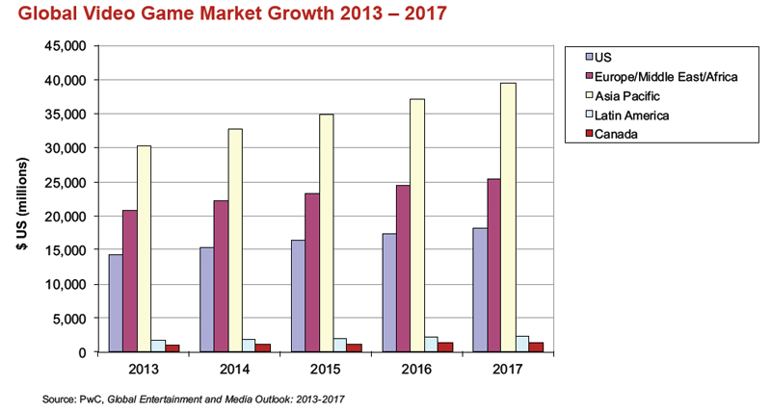
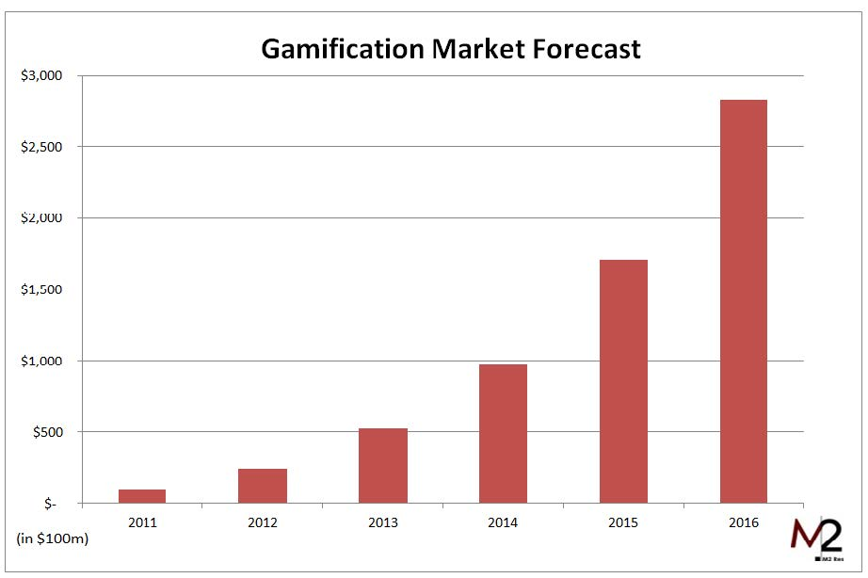
A Background Research – Why Game?
Gamification Industry is growing in an amazing speed
Video game industry is increasing every single year
Video Game would potentially be the most popular industry for multimedia production [1]

Slide 4
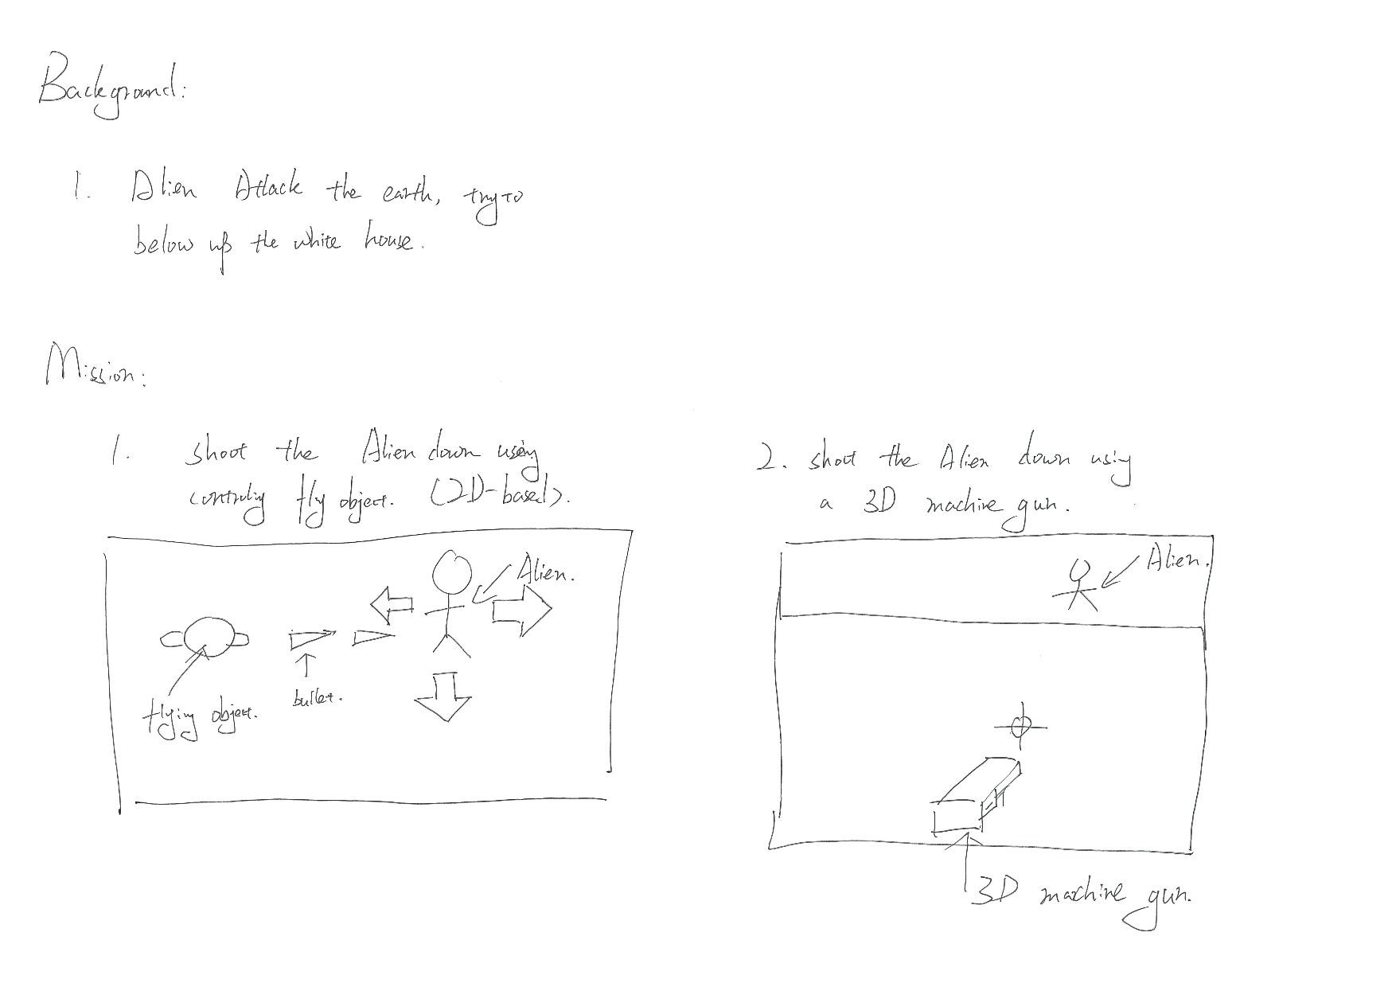
Design – Story Line
Story Line:
Alien invade the earth and try to blow white house up, to save the world and white house, player must fight with alien and shoot them downs in 2 different missions
Story Board:

Slide 5
Design Characters & Environment
Character
Alien (moving in animation time line)
Flying Object (controlled by users)
3D Machine Gun (controlled by users)
Environment
Mission 1 – White House (2D)
Mission 2 – White House (3D)

Slide 6

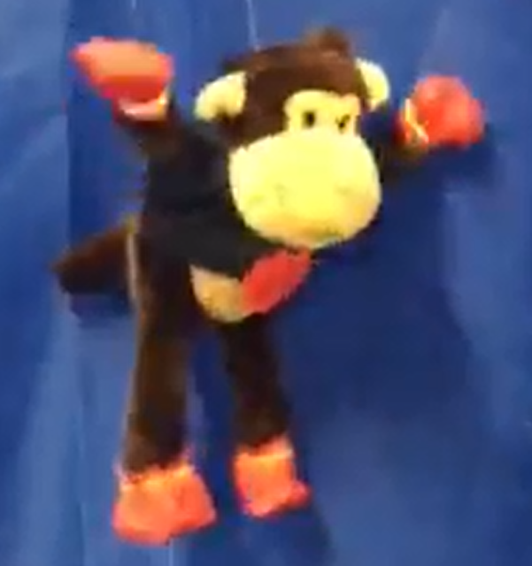
Character - Motion Control
“Actor” of my media
Motion of Character
Step 1 Filtering
Step 2 Tracking
K-means
Max Separation
Get Motion Point and connect to get singleton
Left hand
Right hand
Center
Left foot
Right foot

Slide 7
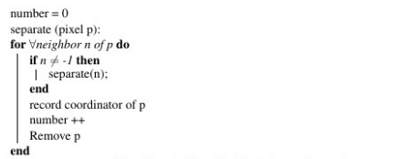
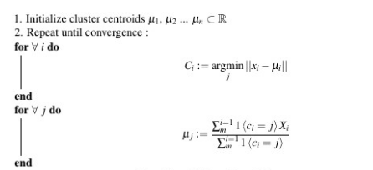
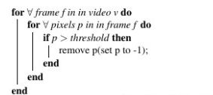
FYI
Filtering Algorithm
K-means[3]
Max-Separation[4]

Slide 8

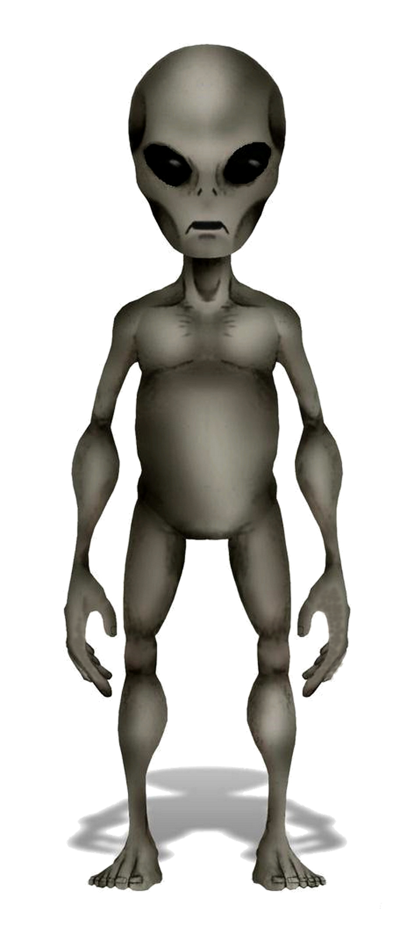
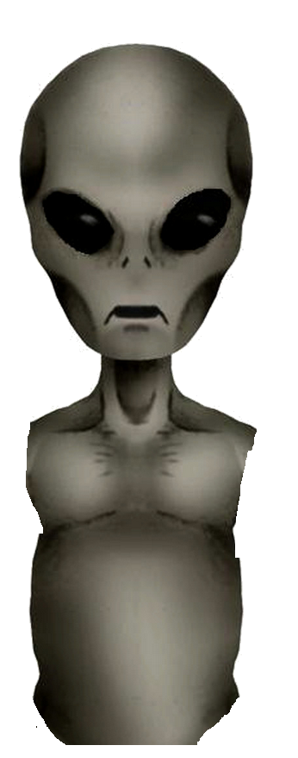
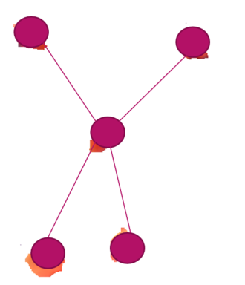
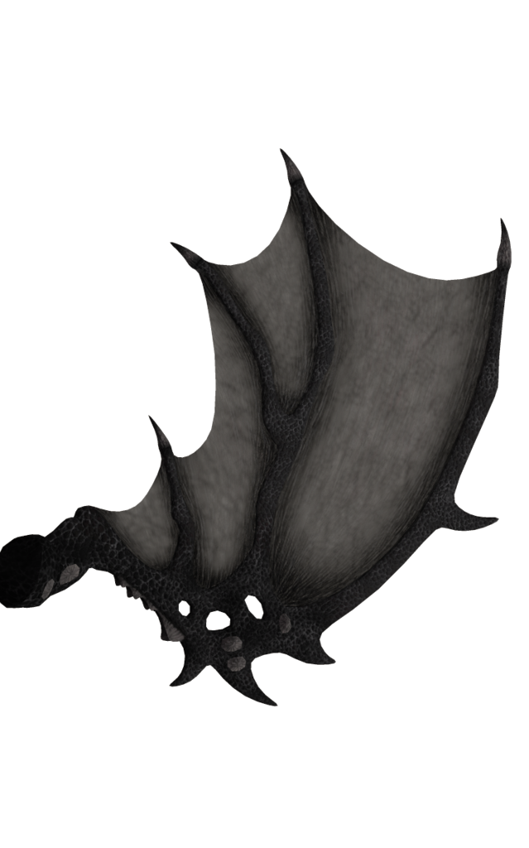
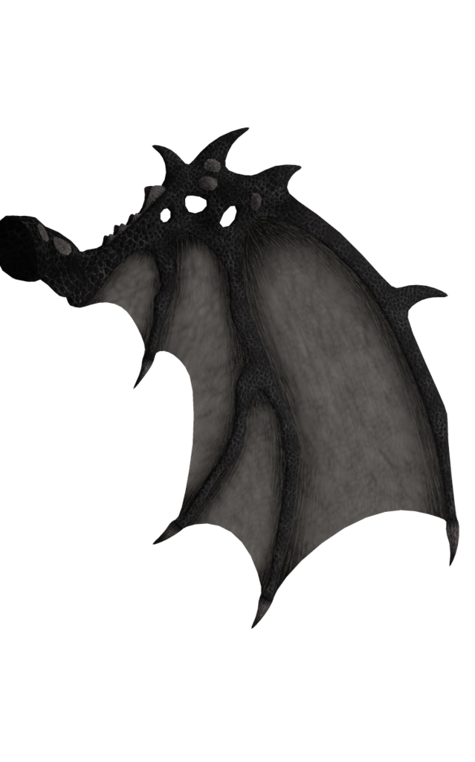
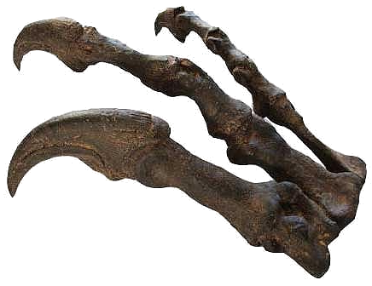
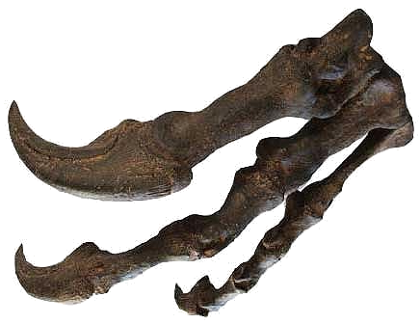
Character - Rendering
mage Enhancement
have source
Reset Region
Set Alpha Channel
Image Compositing
Advantage
Economical
Time-saving
Good for Low-budget Project

Slide 9
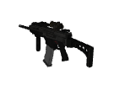
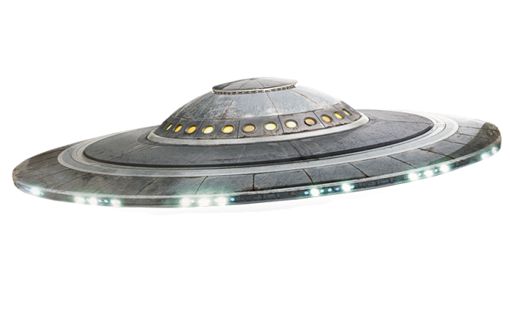
In-game Character
UFO
Use Java to program
Control by user
Left click attack alien
Press W to change weapon, 2 types of weapon
3D Machine Gun
Created by Blender
Extrusion, copy, Material, lighting
Texture using UV-coordinator System

Slide 10
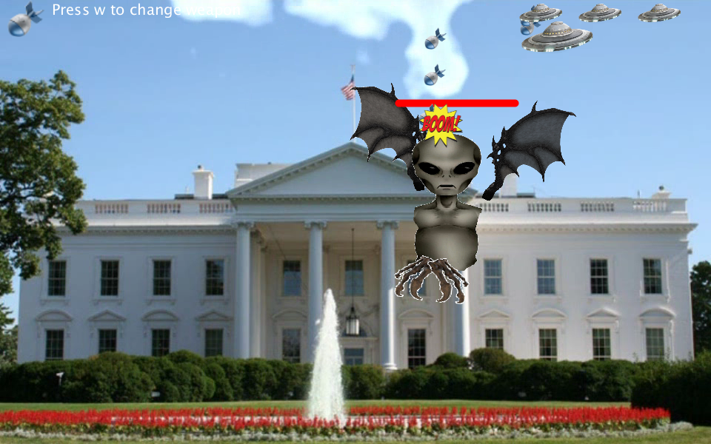
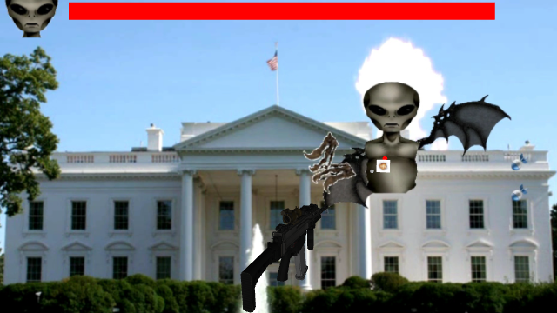
Environment Setting
Background
White House Relevant
Video Techniques
Sound Track
BGM
Interaction Track
Using java BEADS library[6]

Slide 11
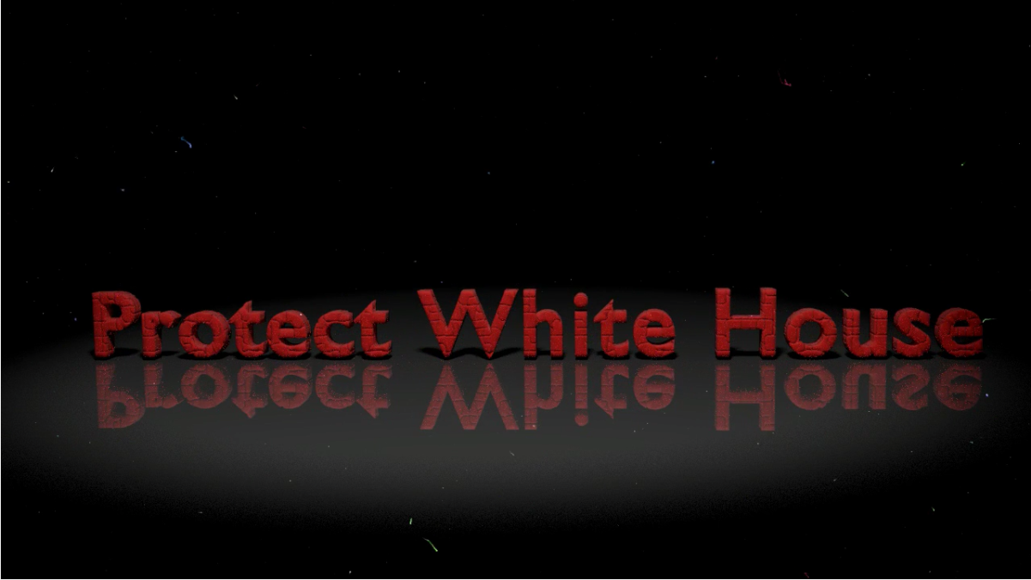
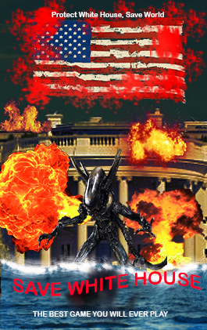
Post Production
Associated Product
Poster
Image Enhancement
Title
3d animation, particle System, lighting
Trailer
Video Skills
Promotion Web
HTML, p5js, Jquery
HCI – getting user experience
Audience is your lord

Slide 12
Reference
[1] http://weplay.co/gamification-success-stories/
[2] http://77-288.com/in.cgi?16&parameter=bc+gambling+trends&ur=1&HTTP_REFERER=http://www.germancarservicescottsdale.com/bc-gambling-trends/
[3] Sites.google.com. (2016). k-means clustering algorithm - Data Clustering Algorithms. [online] Available at: https://sites.google.com/site/dataclusteringalgorithms/k-means-clustering-algorithm [Accessed 21 May 2016].
[4] Stanford.edu. (2016). CS221. [online] Available at: http://stanford.edu/~cpiech/cs221/handouts/kmeans.html [Accessed 21 May 2016].

